Slide 1
Supplier Portal User Guide
03.09.2023

Slide 2
Supplier Portal
Overview
Supplier Portal is an invoice portal used to view payment statuses.
To access navigate to:
https://webapps.rexelusa.com/ords/apexextp/f?p=141

Slide 3
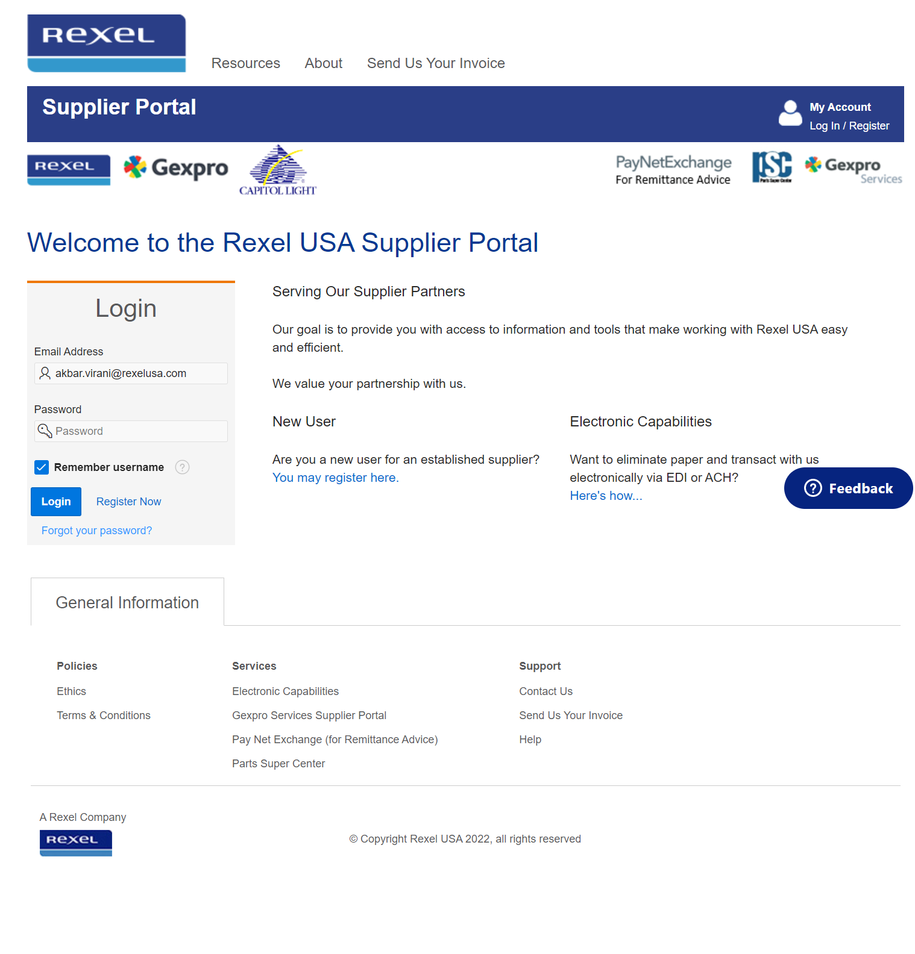
Home/Login Page
Enter your existing login id and password to get password reset email

Slide 4
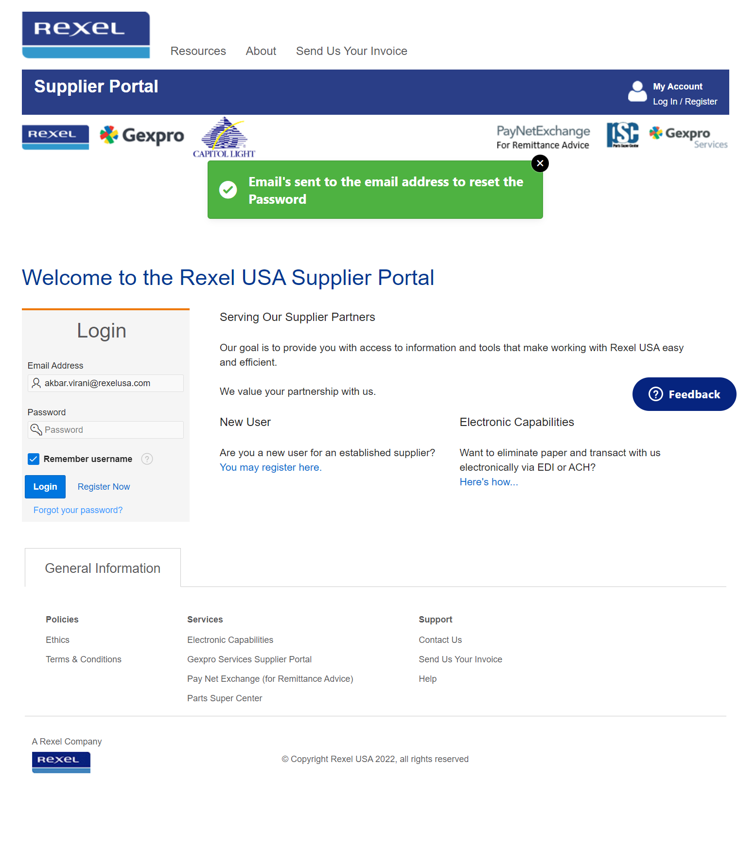
Reset Password Email Notification

Slide 5
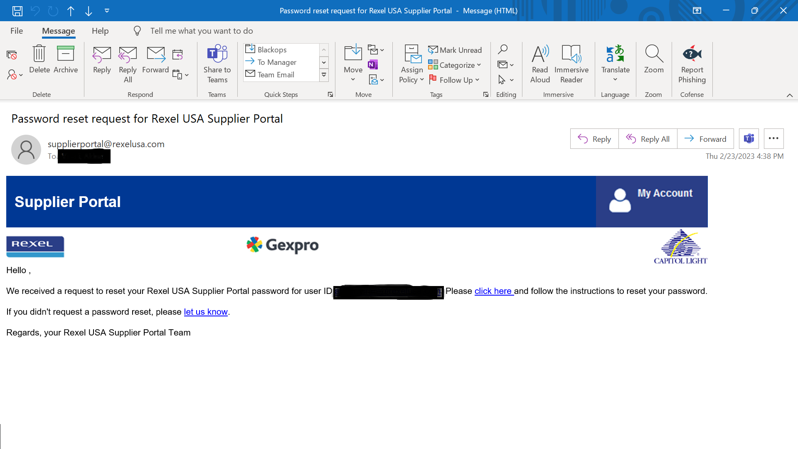
Reset Password Email

Slide 6
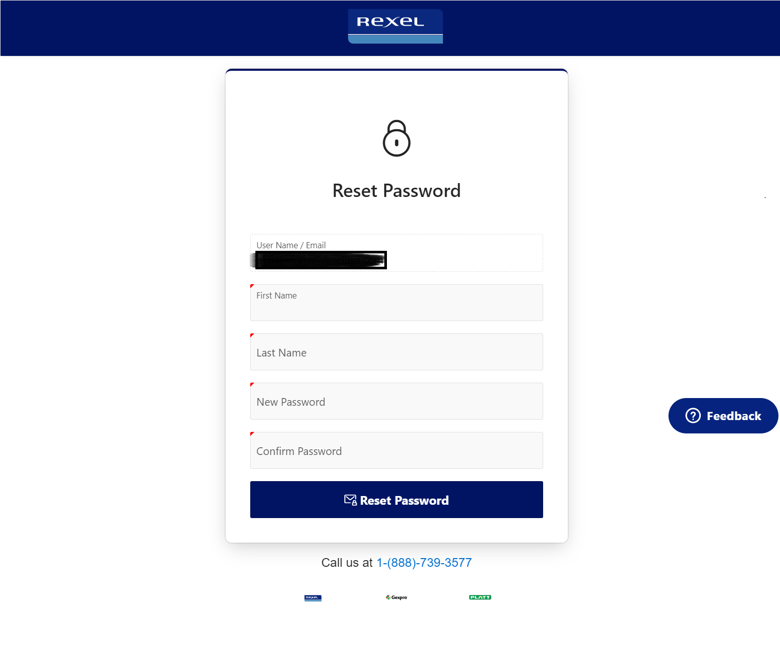
Reset Password page

Slide 7
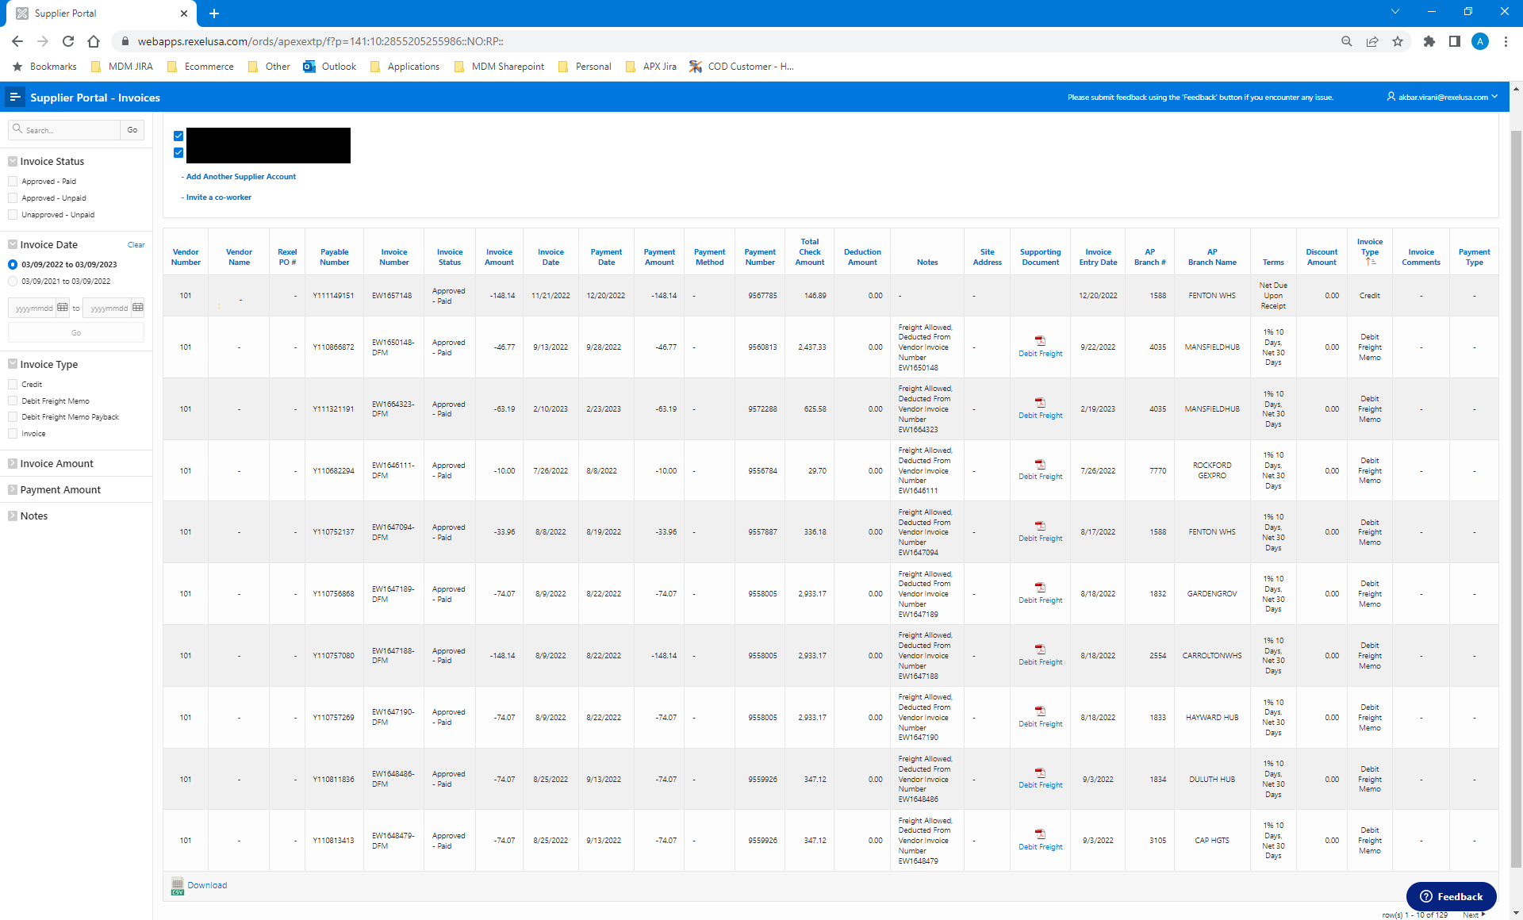
Supplier Portal Navigation
Use the search bar to search all field in the table
Click on any column header to sort by this field.
Example: Invoice date – Newest to oldest
Use the left column to filter within the report.
Click the Feedback button to report issues or suggest enhancements

